Slide 1
The College Scorecard
Gaining Insights Into Higher Education
and Helping Students Find Success

Slide 2
The College Scorecard
Link
Currently, the site allows the user to enter a degree/program of interest, location, size, name, and a few other misc. variables for filtering
Running the search returns a list of schools, as well as the avg. annual cost, the graduation rate, and post-graduation salary (along with the national averages for each)
The user can also Star schools to use the compare tool to see side-by-side statistics

Slide 3
The College Scorecard
This is a great tool for students to do some research in their college decision process; I would like to supply students with even more tools
Using linear regression modeling, I have built a model for the cost of a school based on a number of other variables
Using clustering, I am able to make recommendations on schools to consider, based on cost, size, and locale
With RShiny, I can also provide a UI for students to make custom plots on a large subset of the data available from The College Scorecard

Slide 4
Linear Regression
To predict cost, I removed all NULL records in the training set. This, in effect, filtered down to 2009 - 2013 data (cost must not have been recorded before)
After some trial and error, the strongest model I was able to make was:
Cost ~ Data Year + Highest Degree + Control + SAT Avg. + UGDS + Avg. Faculty Salary + Percent Full Time Faculty + Median Debt + Avg. Family Income
R² for this model was 0.8251
To see if the model was successful, I predicted on 2014 data, for which we already have cost. Then I made two plots - one plot where I overlaid the prediction values on the training data set, and one where I overlaid the prediction values over the 2014 actual cost

Slide 5
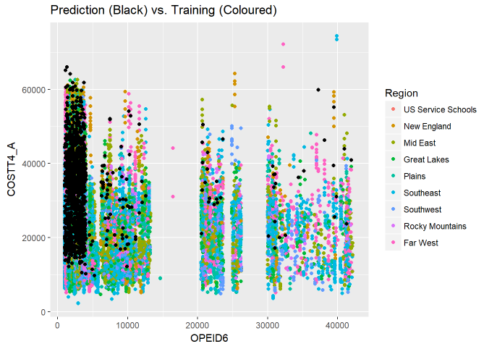
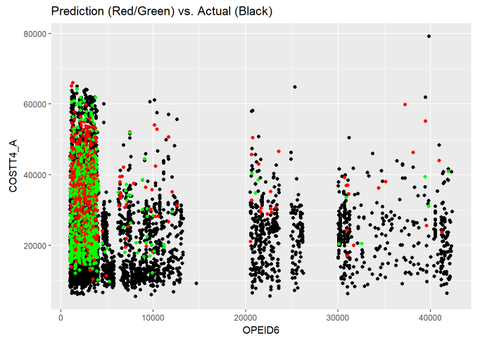
Linear Regression
* green indicates < $4,000 difference, red is > $4,000 difference

Slide 6
Linear Regression
It turns out that there are too many NAs in the 2014 test set for predictions to work for all schools. Predictions happen almost exclusively near left hand side
Could handle the NAs in two ways
Identify, if any, which variables in the model have the most NAs, and remove. This weakens the model slightly, having R² of 0.771 now, but will be able to predict more
Replace NAs with a “neutral” value, like the mean. Will be able to predict on every point, but may cause some to be extremely wrong
I tried both methods and made a plot of predicted vs. actual for both

Slide 7
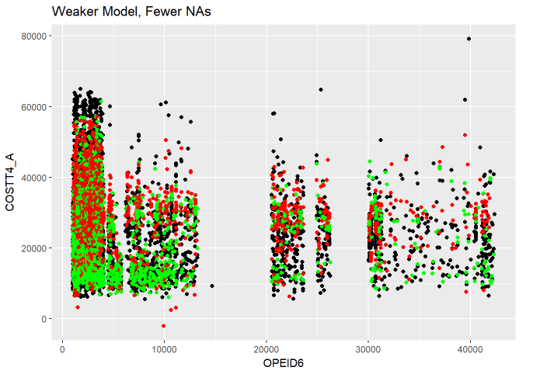
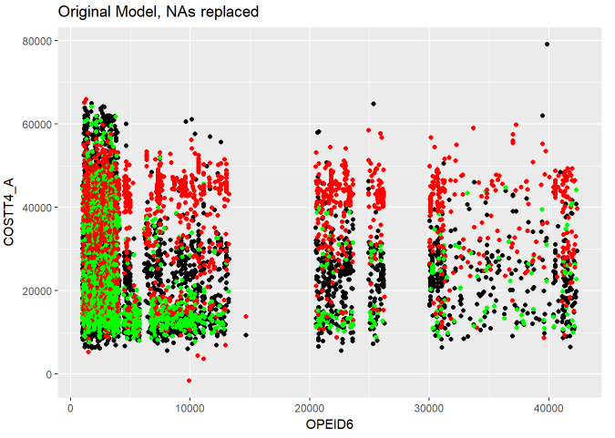
Linear Regression

Slide 8
Linear Regression
These models have clearly predicted on much more than the first model, but it appears as though removing NAs resulted in the better predictions despite a slightly weaker model
Replacing NAs yields many more predictions, but they are also mostly red
Removing NAs has fewer predictions, but not by much, and there is green throughout the plot
The $4,000 window was chosen arbitrarily. If this were provided to a student user, they could set their own based on their finances

Slide 9
Linear Regression
What insights could be drawn from this?
Schools likely won’t change what level of degree they offer or change public/private control, but they could look at admissions
Model coefficients show that Cost and UGDS have a negative correlation, indicating that school prices go up while student population goes down. If the school is able and willing to accept more students, they could reduce costs
Students can also use this model to look at the trends in the cost - if the model suggests cost is going down, they could take a gap year

Slide 10
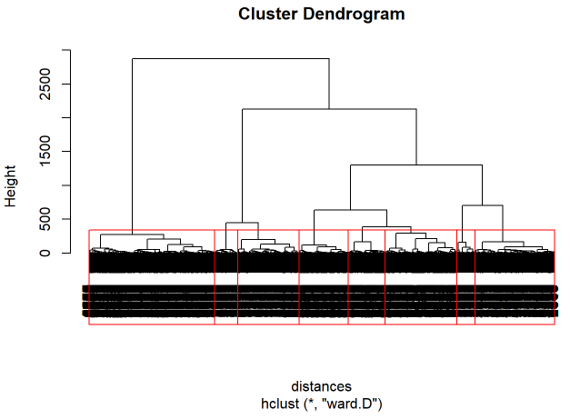
Clustering
Clustering was done on only the 2014 data, since I wanted recommendations to be as current and relevant as possible
Variables used for this were State, Control, Locale, Size, Cost (Academic Year and Program Year), Average Family Income, and Age of Entry
Hierarchical clustering and plotting the dendrogram can suggest how many clusters we should make; 8 in this case

Slide 11
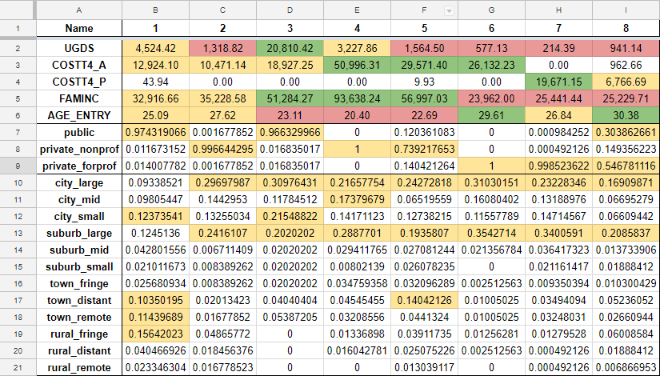
Clustering
After breaking up the dataset into 8 clusters, we can find the means of the variables within each cluster and use that to make classifications

Slide 12
Clustering
From the cluster means, we can define the clusters as the following:
Public, Medium Pop, Mid Cost (A), Mid Family Income, Mid 20s, Varying Locales
Private Non-Profit, Low Pop, Mid Cost (A), Mid Family Income, Mid 20s, Large City/Suburb
Public, High Pop, Mid Cost (A), High Family Income, Low 20s, Large City/Suburb
Private Non-Profit, Medium Pop, High Cost (A), High Family Income, Low 20s, Large City/Suburb
Private Non-Profit, Low Pop, High Cost (A), High Family Income, Low 20s, Large City/Suburb
Private For-Profit, Low Pop, High Cost (A), Low Family Income, Upper 20s, Large City/Suburb
Private For-Profit, Low Pop, High Cost (P), Low Family Income, Mid 20s, Large City/Suburb
Public/Private For-Profit, Low Pop, Mid Cost (P), Low Family Income, Upper 20s, Large City/Suburb

Slide 13
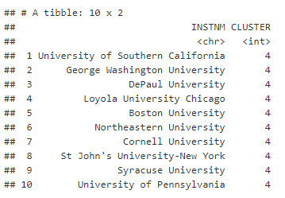
Clustering
Let’s say a student is interested in Drexel University, but they are not sure if they will get accepted, or they would like to see similar alternatives that might be closer geographically
Drexel University is row number 3214 and in cluster 4 (private nonprofit, expensive, large city)
Looking up 3214 in a nearest neighbor matrix will return the 10 closest schools

Slide 14
College Sandbox UI
Link
To cover all bases, I want to give the analytical tools to the students themselves. The College Scorecard site is very thorough, but streamlined
Making custom plots can allow students to answer the questions on their mind with just a few clicks
For example, if a student wanted to see what sort of SAT scores they need to get into a certain school, they can plot SAT avg. on the X axis and admission rates on the Y axis

Slide 15
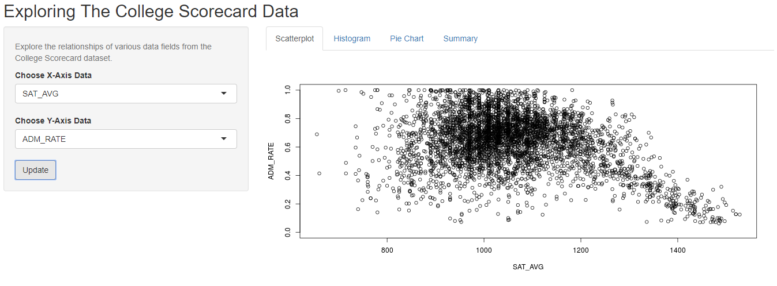
College Sandbox UI

Slide 16
College Sandbox UI
Although the result itself is unsurprising (higher SAT scores are the ones that get into low admission rate schools), having actual numbers can help a student plan ahead or set realistic goals for their school of choice
Since not everything will look good as a scatterplot, there will soon be an option to select bar or pie chart
In the future, I would like to also add modules for the two machine learning tools used previously, so that a user can see cost trends, or do research into the clusters on their own

Slide 17
Final Thoughts
I have immense respect for The College Scorecard, and I hope that students are able to find the steps to success through their service
After seeing the power of statistical analysis on their dataset, I have become quite invested in something that began as just a course project.
My tools only barely scratched the surface of what is available in their dataset; there are lots of discoveries waiting to be made
I believe both students and schools can benefit from the findings. Students can make more intelligent decisions, and schools can improve their internal systems
If interested in seeing the data prep and R code used, please see my Capstone report

Slide 18
Thank You!

